Slide 1
VTK & ParaView
Ray Gasser
rayg@bu.edu
SCV Visualization Workshop – Fall 2008

Slide 2
VTK
Visualization Toolkit
  Set of object oriented class libraries for visualization
  Several language interfaces
    Python
    Tcl
    C++
    Java
    Visual Basic
  Open source
  Standards based
  Portable
  Active developer community
  Good documentation available
  Professional support services available from Kitware
SCV Visualization Workshop – Fall 2008

Slide 3
VTK - Graphics Model
Graphics Model
  Transforms graphical data into pictures
  Consists of the following core objects:
    vtkActor - object in scene
    vtkLight - illumination of scene
    vtkCamera - view of scene
    vtkProperty - appearance of actor
    vtkMapper - geometry of actor
    vtkTransform - positioning of actor, camera, lights
    vtkLookupTable - defines color tables used in scene
    vtkRenderer - manages rendering of scene
    vtkRenderWindow - manages graphics window
    vtkRenderWindowInteractor - manages keyboard and mouse
SCV Visualization Workshop – Fall 2008

Slide 4
VTK - Visualization Model
Visualization Model
  Transforms information into graphical data
  Uses a data flow approach
  Two basic types of objects involved
    vtkDataObject
      represents data of various types
      consist of geometry and topology (points and cells) and attribute data
    vtkProcessObject
      filters which operate on data objects to produce new data objects
      represent visualization algorithms
  Data Objects and Process Objects are connected together to form a visualization pipeline
    Source -> Reader -> Filter -> Mapper -> Actor
SCV Visualization Workshop – Fall 2008

Slide 5
VTK - Sample Code
vtkStructuredGridReader reader
reader SetFileName "Data/density.vtk"
reader Update
vtkContourFilter iso
iso SetInputConnection [reader GetOutputPort]
iso SetValue 0 .26
vtkPolyDataMapper isoMapper
isoMapper SetInputConnection [iso GetOutputPort]
isoMapper ScalarVisibilityOn
vtkActor isoActor
isoActor SetMapper isoMapper
vtkRenderer ren1
vtkRenderWindow renWin
renWin AddRenderer ren1
vtkRenderWindowInteractor iren
iren SetRenderWindow renWin
ren1 AddActor isoActor
renWin SetSize 500 500
renWin Render
SCV Visualization Workshop – Fall 2008

Slide 6
VTK - Readers
Polygonal Data Readers
  vtkBYUReader - read MOVIE.BYU files
  vtkMCubesReader - read binary marching cubes files
  vtkOBJReader - read Wavefront (Maya) .obj files
  vtkPolyDataReader - read VTK polygonal data files
  vtkPLYReader - read Standford University PLY polygonal data files
  vtkSTLReader - read stereo-lithography files
  vtkUGFacetReader - read EDS Unigraphic facet files
Image and Volume Readers
  vtkBMPReader - read PC bitmap files
  vtkDEMReader - read digital elevation model files
  vtkJPEGReader - read JPEG files
  vtkImageReader - read various image files
  vtkPNMReader - read PNM (ppm, pgm, pbm) files
  vtkPNGRReader - read Portable Network Graphic files
SCV Visualization Workshop – Fall 2008

Slide 7
VTK - Readers
Image and Volume Readers (cont)
  vtkStructuredPointsReader - read VTK structured points data files
  vtkSLCReader - read SLC structured points files
  vtkTIFFReader - read files in TIFF format
  vtkVolumeReader - read image (volume) files
  vtkVolume16Reader - read 16-bit image (volume) files
Structured Grid Readers
  vtkPLOT3DReader - read structured grid PLOT3D files
  vtkStructuredGridReader - read VTK structured grid data files
Rectilinear Grid Readers
  vtkRectilinearGridReader - read VTK rectilinear grid data files
Unstructured Grid Readers
  vtkUnstructuredGridReader - read VTK unstructured grid data files
SCV Visualization Workshop – Fall 2008

Slide 8
VTK - Resources
Texts
  The Visualization Toolkit, 4th Edition, Kitware, Inc, 2006.
  The VTK User’s Guide, 5th Edition, Kitware, Inc, 2006.
Websites
  www.vtk.org
  www.kitware.com
  www.vtk.org/doc/release/5.0/html/classes.html
Wiki
  www.vtk.org/Wiki/VTK
Mailing Lists
  public.kitware.com/mailman/listinfo/vtkusers
SCV Visualization Workshop – Fall 2008

Slide 9
ParaView
Parallel Visualization Application
  Multi-platform visualization application
    built on top of VTK
    extensible architecture via plugins
    rich scripting support through Python
    binaries available for Window, OSX, and Linux
  Supports distributed computation of large datasets
    runs on distributed and shared memory parallel systems
    also runs on single processor system
    Client/Server model
  Open source
  Standards based
  Active developer community
  Professional support services available from Kitware
SCV Visualization Workshop – Fall 2008

Slide 10
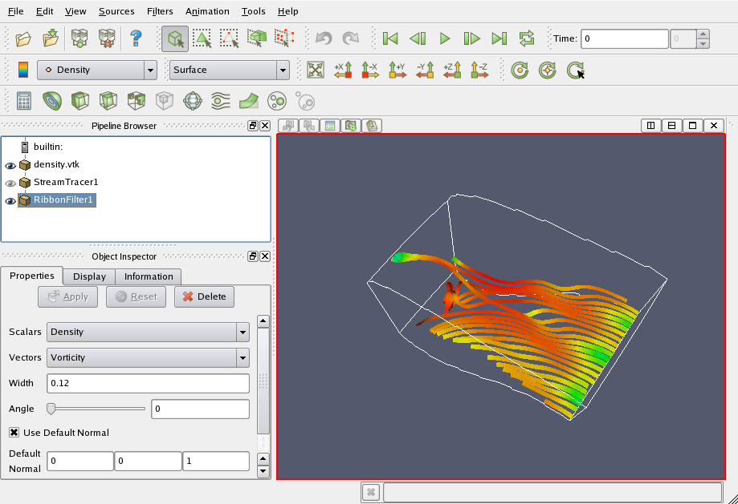
ParaView - User Interface
SCV Visualization Workshop – Fall 2008

Slide 11
ParaView - Models
Visualization Model
  Same as VTK
    Uses a data flow approach
    Data Objects and Process Objects (filters) connected to form a visualization pipeline
  Pipeline
    Visible in the Pipeline Browser
    Built by loading data and attaching filters from menu
Graphics Model
  Same as VTK
    Transforms graphical data into pictures
    core objects: Actors, Lights, Camera, Transforms, Lookup tables, Renderer
  Controlled via object inspector and GUI
SCV Visualization Workshop – Fall 2008

Slide 12
ParaView - Resources
Text
  The ParaView Guide, v3 Edition, Kitware, Inc, 2006.
Websites
  www.paraview.org
  www.kitware.com
Wiki
  www.paraview.org/Wiki/ParaView
Mailing Lists
  public.kitware.com/mailman/listinfo/paraview
SCV Visualization Workshop – Fall 2008

Slide 13
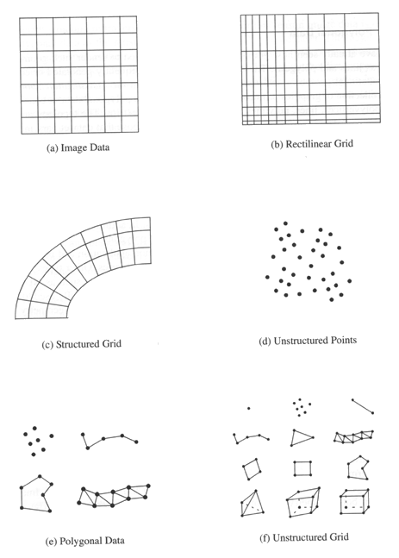
Review of Dataset Types
Image Data (Structured Points)
  regular in both topology and geometry
  examples: lines, pixels, voxels
  applications: imaging CT, MRI
Rectilinear Grid
  regular topology but geometry only partially regular
  examples: pixels, voxels
Structured Grid
  regular topology and irregular geometry
  examples: quadrilaterals, hexahedron
  applications: fluid flow, heat transfer
SCV Visualization Workshop – Fall 2008

Slide 14
Review of Dataset Types
Unstructured Points
  no topology and irregular geometry
  examples: vertex, polyvertex
  applications: data with no inherent structure
Polygonal Data
  irregular in both topology and geometry
  examples: vertices, polyvertices, lines, polylines, polygons, triangle strips
Unstructured Grid
  irregular in both topology and geometry
  examples: any combination of cells
  applications: finite element analysis, structural design, vibration
SCV Visualization Workshop – Fall 2008

Slide 15
Review of Data Attributes
Data attributes associated with the organizing structure
  Scalars
    single valued
    examples: temperature, pressure, density, elevation
  Vectors
    magnitude and direction
    examples: velocity, momentum
  Normals
    direction vectors (magnitude of 1) used for shading
  Texture Coordinates
    used to map a point in Cartesian space into 1, 2, or 3D texture space
    used for texture mapping
  Tensors (generalizations of scalars, vectors and matrices)
    rank 0 ( scalar), rank 1 (vector), rank 2 (matrix), rank3 (3D rectangular array)
    examples: stress, strain
SCV Visualization Workshop – Fall 2008

Slide 16
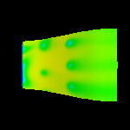
Color Mapping
Color Mapping
  maps scalar data to colors
  implemented by using scalar values as an index into a color lookup table
  VTK
    vtkLookupTable
    vtkDataSetMapper
  ParaView
    Color panel in Display tab of object inspector of data
      Color by
      Edit Color Map
SCV Visualization Workshop – Fall 2008

Slide 17
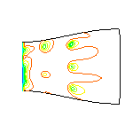
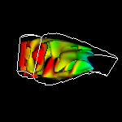
Contouring
Contouring
  construct a boundary between distinct regions
    two steps:
      explore space to find points near contour
      connect points into contour (2D) or surface (3D)
    2D contour map (isoline)
    3D Isosurface
  VTK
    vtkContourFilter
  ParaView
    Contour Filter
SCV Visualization Workshop – Fall 2008

Slide 18
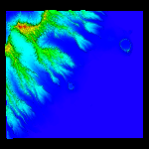
Scalar Generation
Scalar Generation
  extract scalars from part of data
  VTK
    vtkElevationFilter
  ParaView
    Elevation Filter
SCV Visualization Workshop – Fall 2008

Slide 19
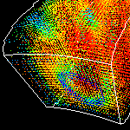
Hedgehogs
Hedgehogs
  Oriented scaled line for each vector
    orientation indicates direction
    scale indicates magnitude
    color indicates magnitude, pressure, temperature, or any variable
  VTK
    vtkHedgeHog
  ParaView
    Glyph Filter
      Set type to line
SCV Visualization Workshop – Fall 2008

Slide 20
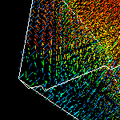
Oriented Glyphs
Oriented Glyphs
  Oriented scaled glyph for each vector
    orientation indicates direction
    scale indicates magnitude
    color indicates magnitude, pressure, temperature, or any variable
  VTK
    vtkGlyph3D
  ParaView
    Glyph Filter
      Set type to arrow
SCV Visualization Workshop – Fall 2008

Slide 21
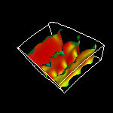
Warping
Warping
  advect a simple object to indicate flow
  vertices individually translated by flow
  VTK
    vtkWarpScalar
  ParaView
    WarpScalar Filter
SCV Visualization Workshop – Fall 2008

Slide 22
Field Lines
  Field Lines
    Fluid flow is described by a vector field in three dimensions for steady (fixed time) flows or four dimensions for unsteady (time varying) flows
    Three techniques for determining flow
      Pathline (Trace)
        tracks particle through unsteady (time-varying) flow
        shows particle trajectories over time
        rake releases particles from multiple positions at the same time instant
        reveals compression, vorticity
      Streamline
        tracks particle through steady (fixed-time) flow
        holds flow steady at a fixed time
        snapshot of flow at a given time instant
      Streakline
        particles released from the same position over a time interval (time-varying)
        snapshot of the variation of flow over time
        example: dye steadily injected into fluid at a fixed point
SCV Visualization Workshop – Fall 2008

Slide 23
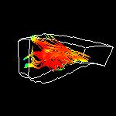
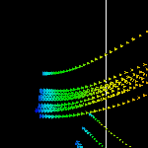
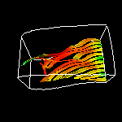
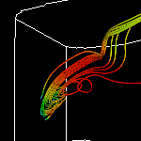
Field Lines
  Streamlines
    Lines show particle flow
    VTK - vtkStreamTracer
    ParaView - StreamTracer Filter
  Streamlets
    half way between streamlines and glyphs
    VTK - vtkStreamTracer, vtkGlyph3D
    ParaView - StreamTracer and Glyph Filters
  Streamribbon
    rake of two particles to create a ribbon
    VTK - vtkStreamTracer, vtkRuledSurfaceFilter
    ParaView - StreamTracer and Ribbon Filters
  Streamtube
    circular rake of particles to create a tube
    VTK - vtkStreamTracer, vtkTubeFilter
    ParaView - StreamTracer and Tube Filters
SCV Visualization Workshop – Fall 2008

Slide 24
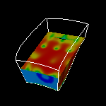
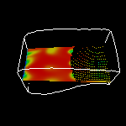
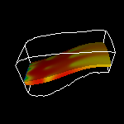
Clipping, Cutting, Subsampling
  Clipping
    can reveal internal details of surface
    VTK - vtkClipDataSet
    ParaView - Clip Filter
  Cutting/Slicing
    cutting through a dataset with a surface
    VTK - vtkCutter
    ParaView - Cut Filter
  Subsampling
    reduces data size by selecting a subset of the original data
    VTK - vtkExtractGrid
    ParaView - ExtractGrid Filter
SCV Visualization Workshop – Fall 2008

Slide 25
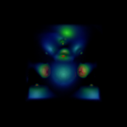
Volume Rendering
Volume Rendering
  used for data that is inherently volumetric
  VTK
    vtkPiecewiseFunction (opacity transfer function)
    vtkColorTransferFunction
    vtkVolumeProperty
    vtkVolumeRayCastCompositeFunction
    vtkVolume
  ParaView
      Style panel in Display tab of object inspector of data
        set Representation to Volume
        edit Color Map for opacity and color transfer function
SCV Visualization Workshop – Fall 2008

Slide 26
Annotation
Annotation
  used for annotating visualization
  VTK
    vtkScalarBarActor
    vtkTextMapper
    vtkScaledTextActor
  ParaView
    Text Source
    Color panel in Display tab of object inspector of data
        edit Color Map
        color legend tab in Color Scale Editor
    Menu: Edit -> View Settings
SCV Visualization Workshop – Fall 2008

Slide 27
Sources
The Visualization Toolkit, 3rd Edition, Will Schroeder, Pearson Education, Inc, 2002.
The VTK User’s Guide, 4.2 Edition, Kitware, 2003.
The ParaView Guide, v3 Edition, Kitware, 2006.
Kitware: www.vtk.org
Kitware: www.paraview.org
SCV Visualization Workshop – Fall 2008

